Slide 1



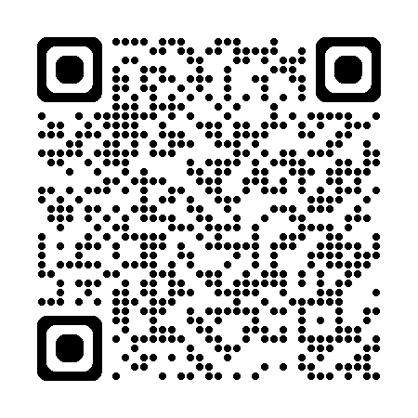
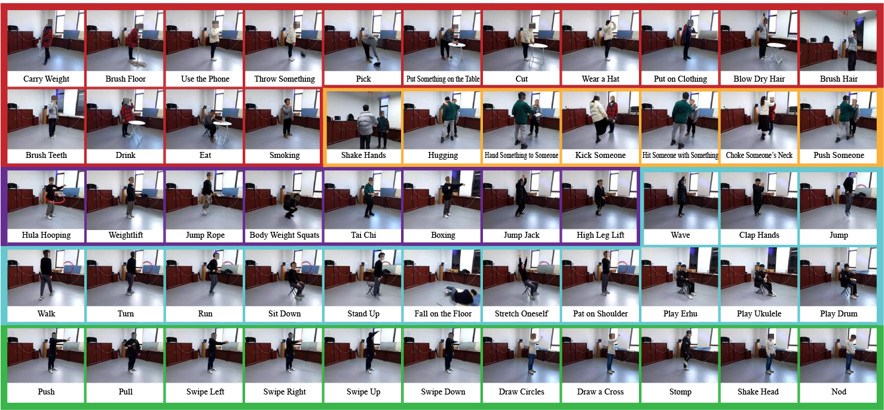
XRF55: A Radio Frequency Dataset for Human Indoor Action Analysis
Fei Wang*, Yizhe Lv, Mengdie Zhu, Han Ding, Jinsong Han
*Project lead, feynmanw@xjtu.edu.cn
: ) scan to access
- 55 action classes
- 42K samples
- Paired Wi-Fi, mm-wave radar, 23 RFID tags, rgb+d+IR videos
Notes:
Good morning/afternoon everyone.
My name is Yunpeng Song, and I am here to present the project titled 'XRF55: A Radio Frequency Dataset for Human Indoor Action Analysis.’
This project was led by Fei Wang in collaboration with Yizhe Lv, Mengdie Zhu, Han Ding, and Jinsong Han.
The main contribution is the development of a novel radio frequency dataset specifically designed for analyzing human indoor actions.

Slide 2
RF solutions for action analysis
RF devices such as Wi-Fi adapters are widely employed in daily life
Promising solutions for indoor action analysis: less privacy concerns than cameras, robustness to lighting conditions and occlusion
Elderly care, health monitoring, smart home control, security surveillance, etc.
However, most RF-based action analysis work remain in the proof-of-concept stage, few large-scale real-world applications
Notes:
RF devices, like Wi-Fi adapters, are commonly found in our everyday environments, making them a convenient and accessible tool for indoor action monitoring.
Unlike cameras, RF-based solutions raise fewer privacy concerns, as they do not capture identifiable images, and they are also robust to environmental factors such as lighting and occlusions.
These attributes make RF-based methods promising for applications in elderly care, health monitoring, smart home systems, and security surveillance.
However, despite their potential, most current RF action analysis efforts remain in the proof-of-concept stage, and large-scale real-world deployments are still limited.

Slide 3
Scaling RF dataset matters in action analysis
Scaling law boosts recent achievements in AI, such as ViT(300M images), CLIP(400M paired text/images), SAM(11M images, 1B masks), LLMs (~15000B tokens for Llama3.1), etc.
In video-based action recognition task, the large-scale Kenatics-400 dataset enable vallina ResNet3D (replace conv2d operations with conv3d) outperforming previous carefully-designed methods
Scaling RF dataset may reduce challenges in real-world deployment, such as for cases of new users in new environment performing new actions with new poses, new orientation, etc. (true zero-shot use in the wild)
Notes:
In AI, we've seen the transformative power of scaling laws, as evidenced by models like Vision Transformers (ViT) trained on 300 million images, CLIP with 400 million text-image pairs, and the Segment Anything Model (SAM) trained on 11 million images and 1 billion masks. Similarly, large language models, such as LLaMA, have been trained on trillions of tokens.
For video-based action recognition, the large-scale Kinetics-400 dataset has enabled even basic models like ResNet3D, which simply extends 2D convolutions to 3D, to outperform more complex, custom-built approaches. This demonstrates that scaling can significantly improve model performance.
Similarly, by scaling RF datasets, we could address challenges in real-world deployments, such as handling new users in unfamiliar environments, performing novel actions in varied poses or orientations. This would bring us closer to achieving true zero-shot performance in real-world settings, where models can generalize to entirely new scenarios without additional training.

Slide 4
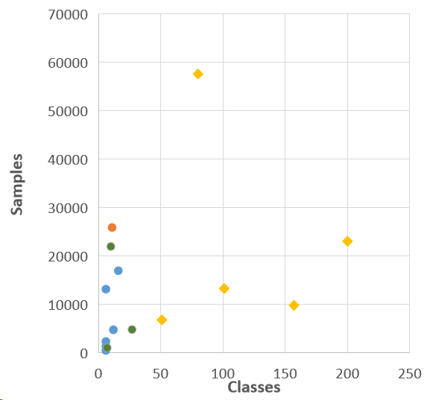
RF datasets even smaller than early video datasets
RF datasets in RF sensing community
WiAR: 6 classes, 557 samples
MM-Fi: 27 classes, 4860 samples
Widar3.0: 16 classes, 17000 samples
mHomeGE: 10 classes, 22000 samples
Early video datasets in AI community
ActivityNet(2015): 200 classes, 23,064 samples
UCF101(2012): 101 classes, 13,320 samples
HMDB51(2011): 51 classes, 6,849 samples
Charades(2016): 157 classes, 9,848 samples
Recent video datasets much bigger
Kinetics-400(DeepMind): 400 classes, 160K samples
Something-Something V2(Google): 174 classes, 220,847 samples
AVA
ActivityNet
Widar3.0, T-PAMI21
UCF101
HMDB51
Charades
MM-Fi, NeurIPS23
Notes:
In the RF sensing community, datasets like WiAR, MM-Fi, Widar3, are much smaller.
In contrast, early video datasets in the AI community, such as UCF101 and HMDB51, already featured hundreds of classes and tens of thousands of samples.
Even more striking is the size of recent video datasets like Kinetics-400 from DeepMind, with 400 classes and 160,000 samples, or Google’s Something-Something V2, which has 174 classes and over 220,000 samples.
This comparison underscores the need for larger RF datasets to parallel the successes seen in video-based action recognition and help RF-based models reach their full potential.

Slide 5
To scale up RF dataset, we consider...
Which kind of actions?
Indoor actions: most potential use scenarios
Which categories?
UCF101: Human-Object Interaction; Body-Motion Only; Human-Human Interaction; Playing Musical Instruments; Sports
HMDB51: Body movements with object interaction; General body movements; Body movements for human interaction
Kenatics-400: Person-Object Actions; Person Actions (singular) ; Person-Person Actions
Which actions?
Selecting action from video datasets -> for more action classes
Selecting action from RF papers -> for RF sensing scenarios
Which RF?
Widely exploited modalities: RFID (dm), Wi-Fi (cm), millimeter-wave radar (mm)
Notes:
To scale up RF datasets effectively, there are several key questions we need to address.
First, which types of actions should we focus on? Since most potential use cases for RF-based action recognition are indoors, indoor actions are our primary target.
We can draw inspiration from existing video datasets to categorize actions. For instance, UCF101 includes categories like human-object interaction, body-motion only, and human-human interaction. Similarly, HMDB51 and Kinetics-400 classify actions into person-object interactions, singular person actions, and person-person interactions.
The next step is selecting specific actions. We can either pull from video datasets to add more action classes or reference actions from existing RF papers that align with common RF sensing applications.
Finally, we need to consider which RF technology to use. The most widely used modalities include RFID for decimeter-wave sensing, Wi-Fi for centimeter-wave sensing, and millimeter-wave radar for even finer resolution.

Slide 6
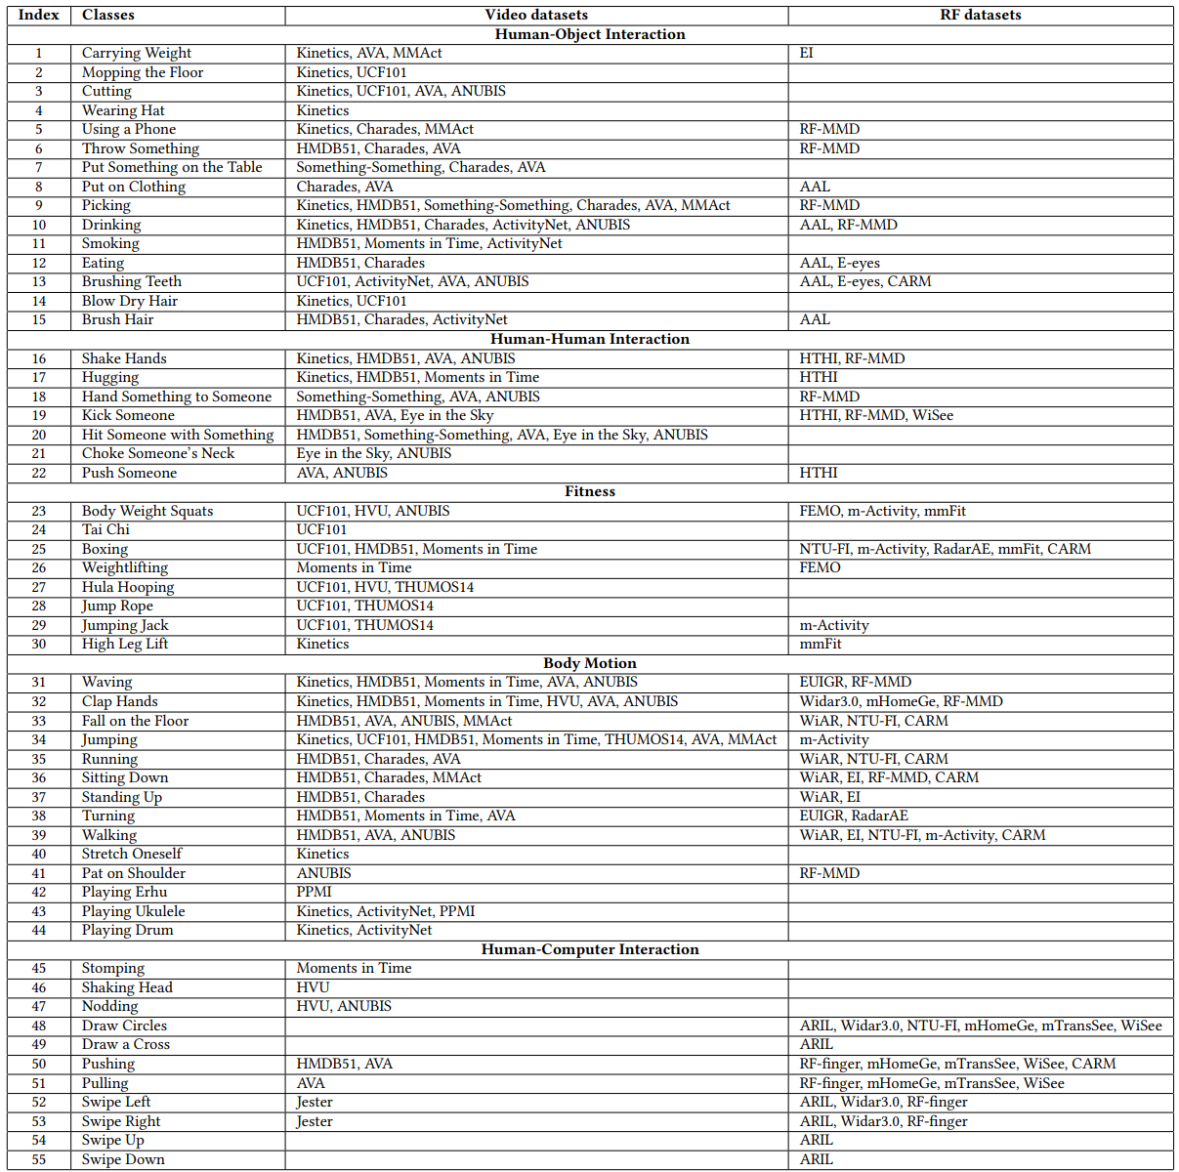
We refer to:
16 video action datasets, i.e., Kinetics, UCF101, HMDB51, Something-Something, Charades, Moments-in-Time, HVU, Jester, ActivityNet, THUMOS14, AVA, MMAct, Eye in the sky, ANUBIS, PPMI, and FineGym
19 RF sensing papers, i.e., WiAR, EI, ARIL, HTHI, Widar3.0, NTU-FI, FEMO, RF-finger, EUIGR, AAL, mHomeGe, m-Activity, mTransSee, RadarAE, mmFit, RF-MMD, E-eyes, WiSee, and CARM
Notes:
In this project, we have referred to a wide range of both video action datasets and RF sensing papers.
From the video domain, we analyzed 16 key datasets, including well-known examples like Kinetics, UCF101, HMDB51, and Something-Something, among others.
In addition, we studied 19 RF sensing papers, such as WiAR, Widar3.0, NTU-FI, RF-finger, and E-eyes.
By leveraging the knowledge from both AI and RF communities, we aim to design a comprehensive and scalable RF dataset that can handle a wide range of actions and real-world challenges.

Slide 7
XRF55: 5 categories, 55 action classes
15 Human-Object Interaction Actions. Whole-home daily: carrying weight, mopping the floor, using a phone, throwing something, picking something, putting something on the table; Kitchen: cutting something; Dress: wearing a hat, putting on clothing; Bathroom: blowing dry hair, combing hair, brushing teeth; Healthcare: drinking, eating, and smoking.
7 Human-Human Interaction Actions. Social actions: shaking hands, hugging, handing something to someone; Violence actions for applications of domestic violence and invasion detection: kicking someone, hitting someone with something, choking someone’s neck, and pushing someone.
8 Fitness Actions. With equipment: hula hooping, weightlifting, jumping rope; Without equipment: body weight squats, Tai Chi, boxing, jumping jack, and high leg lifting.
14 Body Motion Actions. Whole-home daily: waving, clapping hands, jumping, walking, turning, running, sitting down, standing up; Healthcare: falling on the floor, stretching, patting on the shoulder; Musical instruments: playing Er-Hu, playing Ukulele, playing drum.
11 Human-Computer Interaction Actions. Hand gestures: pushing, pulling, swiping left, swiping right, swiping up, swiping down, drawing a circle, drawing a cross; When hands are not free: foot stamping, shaking head, and nodding.
Notes:
The XRF55 dataset has five action categories, a total of 55 action classes.
15 Human-Object Interaction Actions. Including Whole-home daily actions, actions in kitchen, in bathroom, and healthcare actions such as drinking, eating, and smoking.
7 Human-Human Interaction Actions. Including Social actions: shaking hands, hugging, and Violence actions for applications of domestic violence and invasion detection.
8 Fitness Actions. With equipment such as hula hooping, and actions Without equipment, such as Tai-Chi and high leg lifting.
14 Body Motion Actions. Including Whole-home daily actions. Healthcare actions such as falling on the floor, stretching, patting on the shoulder. And playing musical instruments, such as playing er-hu, drum, and ukulele.
11 Human-Computer Interaction Actions. Hand gestures, such as push and pull. And interaction actions for situations When hands are not free, such as foot stamping, shaking head, and nodding.
The diversity of actions represented in the XRF55 dataset makes it a valuable resource for various applications, including smart home technology, healthcare monitoring, and security systems.

Slide 8
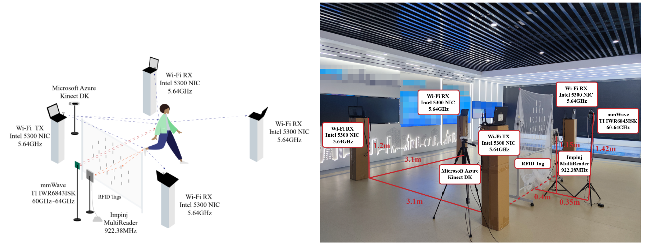
XRF55: 3 RF modalities and paired RGB-D-IR video clips
Timeline: 2022.7-10 deployment test -> 2022.11 users in scene 1 -> (winter break) -> 2023.2, 18 users in scene 1 -> 2023.6, 9 users in scene2/3/4, it takes nearly one year to collect XRF55 dataset
23 RFID tags at 922.38MHz, inspired by RF-pad
9 Wi-Fi links at 5.64GHz, inspired by Widar3.0
1 millimeter-wave radar at 60-64GHz
1 Azure Kinect, RGB+D+IR
Notes:
The XRF55 dataset incorporates three RF modalities alongside paired RGB-D-IR video clips.
The timeline for the dataset's collection spans nearly a year.
The dataset utilizes various technologies, including:
23 RFID tags.
9 Wi-Fi.
1 millimeter-wave radar functioning in the 60-64GHz range.
1 Azure Kinect, which captures RGB, depth, and infrared data.
The combination of these modalities enriches the dataset, providing a comprehensive basis for action recognition and analysis in indoor environments.

Slide 9
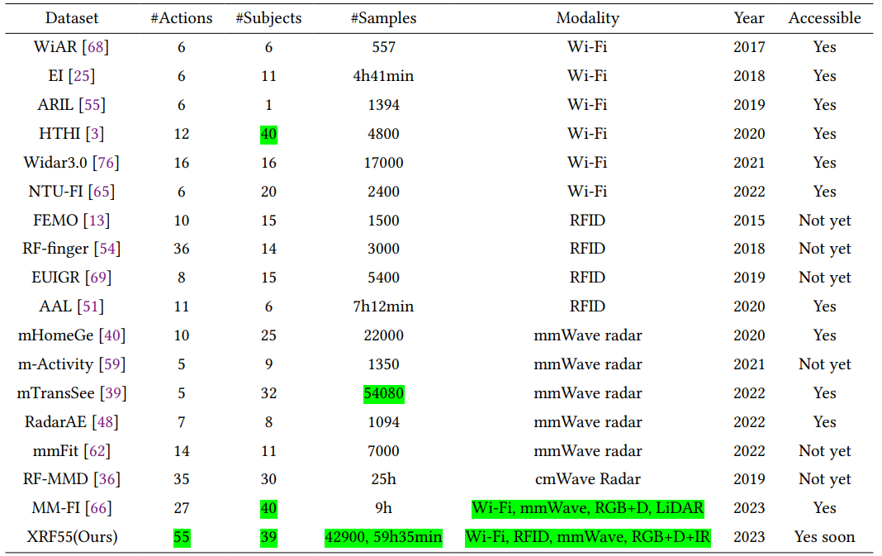
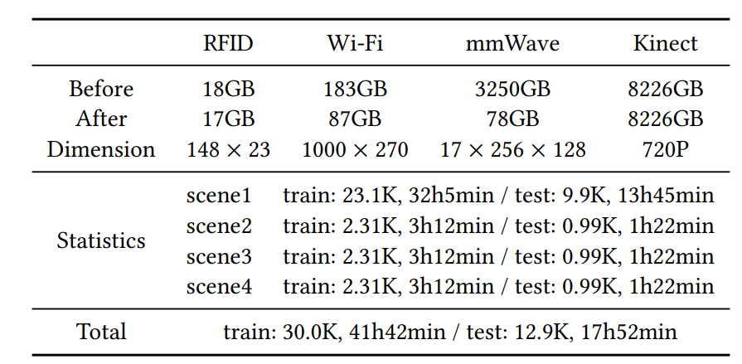
Statistics of XRF55
39 subjects, 4 scenes, 55 action classes, each action repeated 20 times
39x55x20=42,900 samples，over 59 hours of effective duration
Advantages in # action classes, # samples, duration, diversity of sensing modalities
Raw RF data: 3TB; After preprocessing: 180GB
All are open-sourced for publicly accessible
Notes:
The XRF55 dataset comprises a total of 39 subjects engaging in 4 different scenes, covering 55 distinct action classes, with each action being repeated 20 times.
This leads to an impressive total of 42,900 samples, amounting to over 59 hours of effective action duration.
Compared to existing open-sourced or non-open-sourced RF work, XRF55 has good advantages in the number of action classes, number of samples, duration, and diversity of sensing modalities
In terms of data volume, the raw RF data collected amounts to 3TB, and after preprocessing, it is reduced to 180GB, making it more manageable for researchers.
Importantly, all components of the XRF55 dataset are open-sourced, ensuring accessibility for researchers and developers in the community.

Slide 10
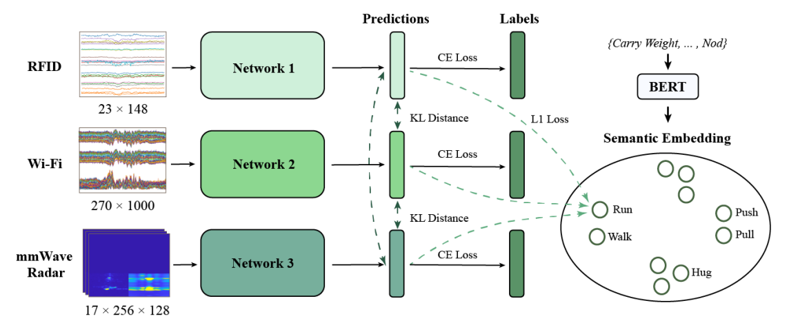
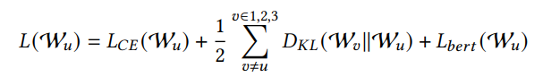
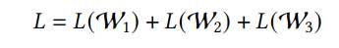
XRF55 support research on RF modality collaboration
Motivation: In the future, there will be multiple modal RF devices entering indoor spaces
Purpose: Each device/modality can operate independently for the cases of others non-operational
Mutual learning framework:
Not teacher-student framework, not modality fusion
But all modalities learns from each other with KL-divergence losses
After learned, every modality can operate independently
Notes:
The XRF55 dataset supports research on RF modality collaboration.
Motivation: As the number of RF devices increases in indoor environments, it becomes crucial to explore how these multiple modal RF devices can effectively operate together.
Purpose: The goal of this research is to enable each device or modality to function independently, ensuring that even if some devices are inaccessible or non-operational.
This framework is distinct from traditional teacher-student models and modality fusion approaches.
The framework utilizes KL-divergence losses to facilitate knowledge transfer among modalities, allowing them to benefit from shared information while maintaining their unique operational capabilities.
Once the learning process is complete, each modality can operate independently without relying on the others, making the system more resilient and flexible.

Slide 11
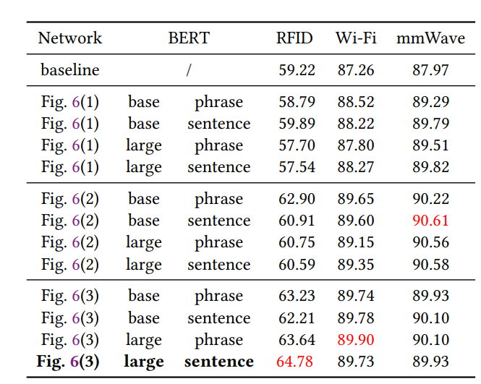
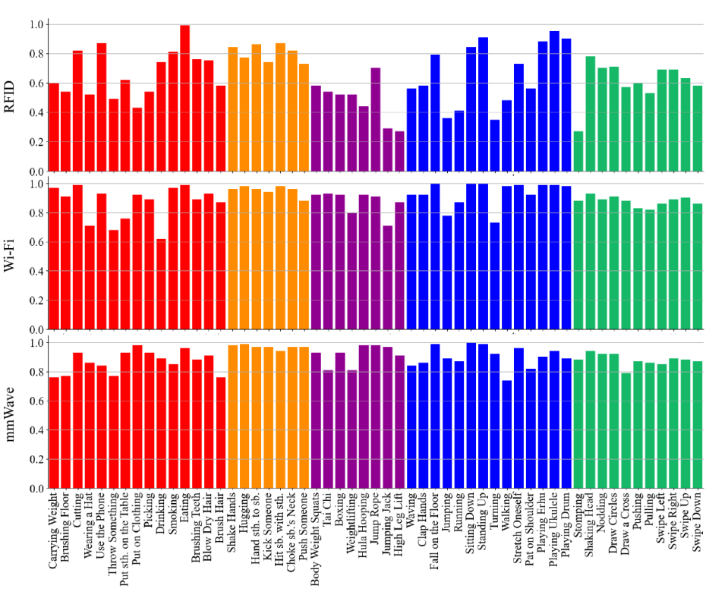
Modality collaboration helps in action recognition
RFID: 59.22% -> 64.78%
Wi-Fi: 87.26% -> 89.73%
mmWave: 87.97 -> 89.93%
Notes:
Modality collaboration plays a significant role in enhancing action recognition performance across different RF modalities.
RFID Performance: The action recognition accuracy for RFID improved from 59.22% to 64.78%, demonstrating a notable enhancement due to collaborative learning.
We also see enhancement in Wi-Fi, and mmWave radar performance.

Slide 12
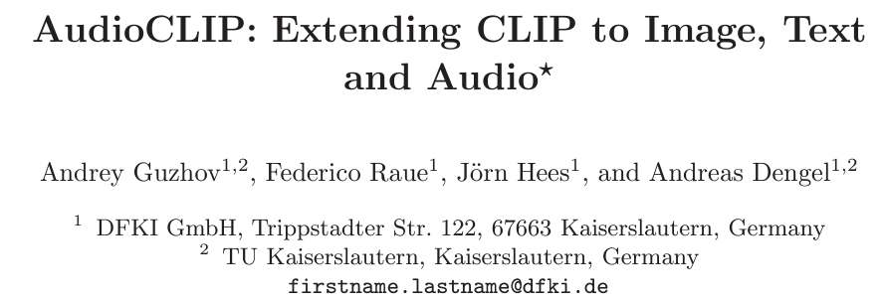
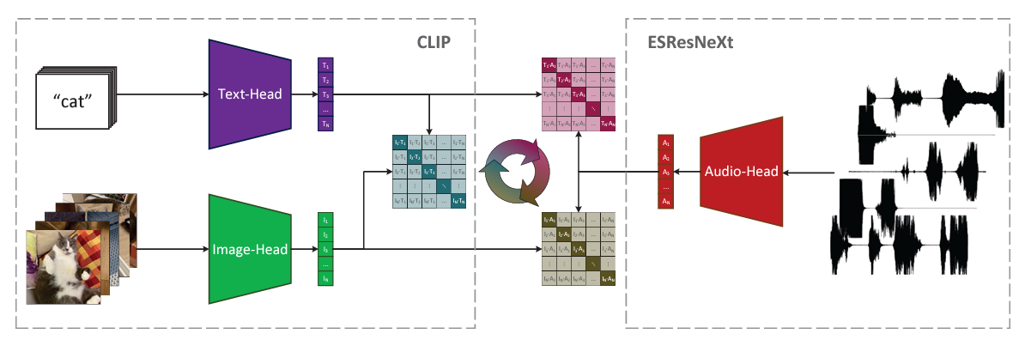
Follow-up work 1: RF-CLIP for zero-shot action recognition
Inspired by CLIP, VideoCLIP, and AudioCLIP
XRF55 has paired action labels, videos, and RF data
Frozen: Action labels to input Text-Head w./w.o prompt engineering, e.g., “An action of {}”
Frozen: Videos to input Image-Head, such as pre-trained VideoCLIP
Fine-tuning: RF data to input Audio-Head, parameter-efficient fine-tuning Audio-Head (LoRA, Adapter)
Notes:
XRF55 supports some other research.
For example, one follow-up work, RF-CLIP, is inspired by the architecture and methodologies of existing models like CLIP, VideoCLIP, and AudioCLIP.
Here are the main components of the RF-CLIP framework:
1. The XRF55 dataset provides a unique advantage as it contains paired action labels, videos, and RF data.
2. The action labels are fed into a frozen Text-Head, which can operate with or without prompt engineering. For instance, using a prompt like "An action of {}"
3. The video data is input into a frozen Image-Head, typically utilizing a pre-trained model like VideoCLIP. This enables the model to extract features from the visual domain without requiring extensive retraining.
4. The RF data serves as input to the Audio-Head, which undergoes fine-tuning, such as LoRA and Adapter.
Overall, this work aims to leverage multimodal learning for zero-shot action recognition, potentially enabling applications across diverse environments without requiring extensive retraining on new actions.

Slide 13
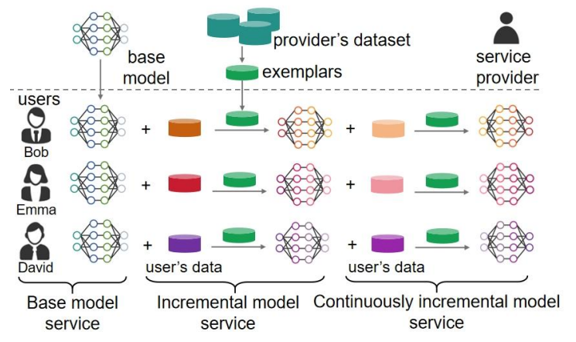
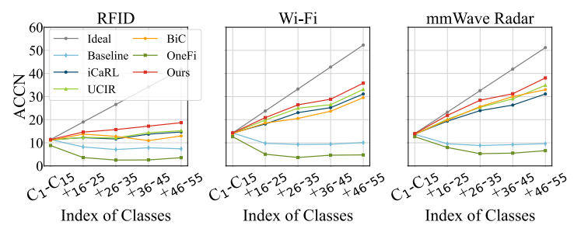
Follow-up work 2: RF Class Incremental Learning
Motivation: In the future, there will be RF sensing service providers to provide models to users
Purpose: Provides updates models to support customized models for different users
Class Incremental learning, one kind of continuous learning
XRF55 has 55 action classes
Take one subset of actions to train a base model as base services
Take other actions to update models continuously as continuous customized services
Notes:
Another follow-up work focuses on the concept of RF Class Incremental Learning, which is essential for adapting to the evolving needs of users.
The Motivation is, In the future, there will be RF sensing service providers to provide models to users
Purpose: The primary goal is to provide updated models that support customized functionalities for diverse user needs. This customization can enhance user experience and increase the practicality of RF sensing applications.
Class Incremental learning allows models to learn from new classes of data while retaining knowledge from previously learned classes, making the system more versatile and responsive.
The XRF55 dataset contains 55 action classes.
Initially, a subset of actions will be used to train a base model. This base model will serve as the foundational service offering for users.
As new actions are introduced, the model can be continuously updated to incorporate these new classes. This ensures that users have access to the most relevant and current models tailored to their unique requirements.
By employing RF Class Incremental Learning, we can create a responsive and user-centric RF sensing ecosystem that evolves alongside the needs of its users, promoting enhanced usability and adaptability in various applications.

Slide 14
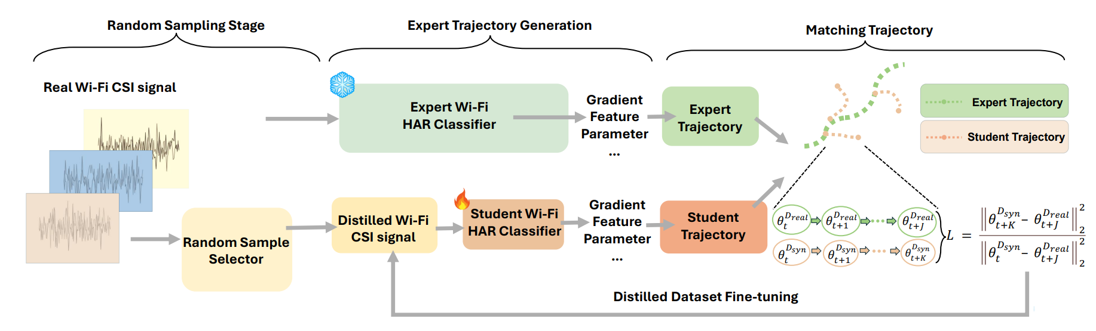
Follow-up work 3: RF Dataset Distillation
Motivation: In the future, there will be RF sensing data in large volume
Purpose: To save storage and fasten model training
Dataset Distillation
XRF55 has 420 training samples for each action
Distill XRF55 to one/tens sample for each action, train a model with distilled XRF55, to achieve comparable action recognition accuracy, compared with trained with the full XRF55
Notes:
Another follow-up work focuses on RF Dataset Distillation, a critical strategy for managing the challenges posed by large volumes of RF sensing data.
Motivation: As RF sensing technology progresses, we anticipate the generation of vast amounts of RF data. This increase in data volume can present storage challenges and slow down model training processes.
Purpose: The main goal of dataset distillation is to reduce the storage requirements of large datasets while simultaneously speeding up the model training process.
The XRF55 dataset contains 420 training samples for each action, providing a substantial amount of data for effective training.
By employing dataset distillation techniques, we can reduce the XRF55 dataset to ones/tens samples for each action.
A model will be trained using the distilled version of XRF55.
The aim is to achieve comparable action recognition accuracy to that of the model trained with the full XRF55 dataset.

Slide 15
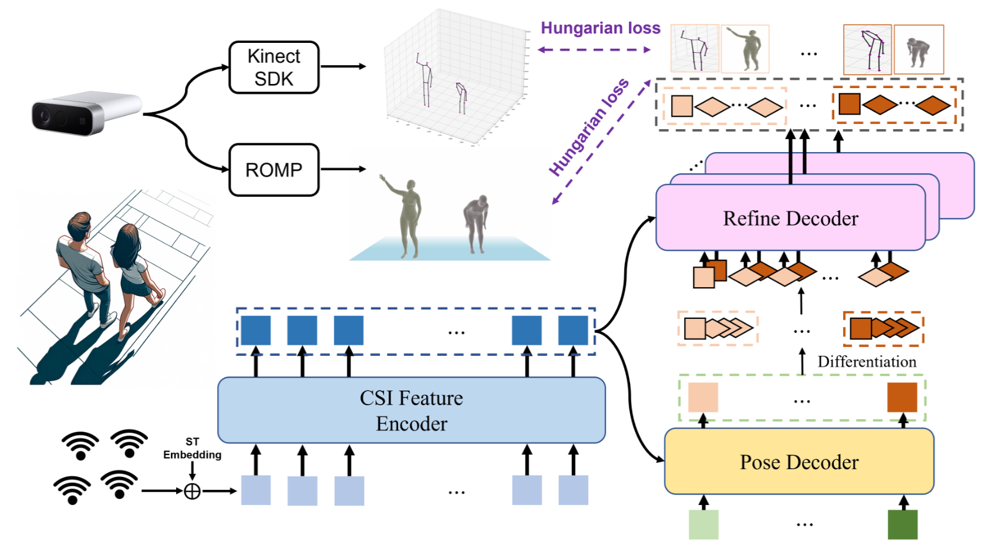
Follow-up work 4: Multi-person 3D pose/shape from RF
Person-in-WiFi 3D: End-to-End Multi-Person 3D Pose Estimation with Wi-Fi
Kangwei Yan, Fei Wang*, Bo Qian, Han Ding, Jinsong Han, Xing Wei
Proceedings of the IEEE/CVF Conference on Computer Vision and Pattern Recognition (CVPR), 2024
Extended version to submit to IEEE T-PAMI
Notes:
Another our latest published work, which focuses on multi-person 3D pose estimation using RF signals.
The work is titled 'Person-in-WiFi 3D: End-to-End Multi-Person 3D Pose Estimation with Wi-Fi,' which has been accepted for presentation at CVPR 2024.
Objective: This research addresses the challenge of estimating the 3D pose of multiple individuals in real-time using Wi-Fi signals. It presents a novel approach to capture human movement and posture without the need for traditional visual sensors.
Future Work: We are also preparing an extended version of this work for submission to IEEE Transactions on Pattern Analysis and Machine Intelligence (T-PAMI), aiming to share further insights and advancements in the field of RF-based pose estimation.

Slide 16

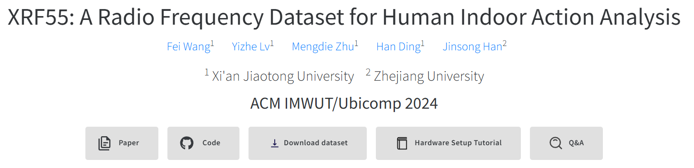
We envision XRF55 facilitates more research
To access XRF55, https://aiotgroup.github.io/XRF55/
1. Source code
2. All dataset (videos to share with email)
3. Tutorial for hardware setup including Wi-Fi, RFID, mm-Wave radar, Kinect
4. Tutorial to use XRF55
5. Q&A on XRF55
Notes:
In this concluding slide, we highlight our vision for the XRF55 dataset to support ongoing research in the field of RF sensing and action recognition.
We welcome researchers to explore and utilize the XRF55 dataset. Access can be gained through our dedicated webpage.
In the project website. We share
1. Source code
2. All dataset (videos to share with email)
3. Tutorial for hardware setup including Wi-Fi, RFID, mm-Wave radar, Kinect
4. Tutorial to use XRF55
5. Q&A on XRF55
By providing these resources, we hope to inspire further innovation and research collaborations in the area of RF sensing and action analysis.

Slide 17

Thank you! Q&A!
We welcome discussion and collaboration!
Fei Wang (王飞)
Associate Professor, Xi’an Jiaotong University, China
feynmanw@xjtu.edu.cn
: ) scan to access
- 55 action classes
- 42K samples
- Paired Wi-Fi, mm-wave radar, 23 RFID tags, rgb+d+IR videos
Notes:
We welcome questions and discussion. Together, we can drive innovation in RF sensing and action analysis.
You are welcome to scan this QR-code to add Dr. Fei Wang on WeChat for discussion and communication.
We look forward to feedbacks and collaboration! Thank you for your attention!
问题1，视频怎么下载：The video is currently not available for public download. It is approximately 9TB and stored in Alibaba Cloud Drive. Due to the sharing restrictions of the cloud drive, the video can only be sent through individual private links. Everyone is welcome to contact Fei Wang for the link.
问题2：视频的标注有哪些：The video currently consists of RGB+D+IR, with five channels. We have provided code and tutorials on our website to separate each channel. Currently, the video only has action category annotations. Annotations for pose and mesh can be extracted using tools such as Kinetic SDK or ROMP.
问题3：毫米波雷达数据是什么：After processing the millimeter-wave data, we have heatmaps for range-Doppler and range distance. We also provide the raw data on our website for everyone to process it into other formats, such as point cloud data.
问题4：有没有动作起止时刻的标注：There are no annotations for the start and end times of actions, but if needed, they can be obtained through the synchronized video.
问题5：动作是连续的吗：The actions are not continuous; the dataset has been cut into 5-second clips, with one action performed within each 5-second period.

Slide 18
Q&A!
1. How to access video dataset：The video is currently not available for public download. It is approximately 9TB and stored in Alibaba Cloud Drive. Due to the sharing restrictions of the cloud drive, the video can only be sent through individual private links. Everyone is welcome to contact Fei Wang for the video link.
2. What annotations are available for the videos. The video currently consists of RGB+D+IR, with five channels. We have provided code and tutorials on our website to separate each channel. Currently, the video only has action category annotations. Annotations for pose and mesh can be extracted using tools such as Kinetic SDK or ROMP. There are no annotations for the start and end times of actions, but if needed, they can be obtained through the synchronized videos.
3. What format does millimeter-wave radar data take? After processing the millimeter-wave data, we have heatmaps for range-Doppler and range distance. We also provide the raw data on our website for everyone to process it into other formats, such as point cloud data.
4. Is the action continuous? The actions are not continuous; the dataset has been cut into 5-second clips, with one action performed within each 5-second period.
Add on WeChat
feynmanw@xjtu.edu.cn
Notes:
We welcome questions and discussion. Together, we can drive innovation in RF sensing and action analysis.
You are welcome to scan this QR-code to add Dr. Fei Wang on WeChat for discussion and communication.
We look forward to feedbacks and collaboration! Thank you for your attention!
问题1，视频怎么下载：The video is currently not available for public download. It is approximately 9TB and stored in Alibaba Cloud Drive. Due to the sharing restrictions of the cloud drive, the video can only be sent through individual private links. Everyone is welcome to contact Fei Wang for the link.
问题2：视频的标注有哪些：The video currently consists of RGB+D+IR, with five channels. We have provided code and tutorials on our website to separate each channel. Currently, the video only has action category annotations. Annotations for pose and mesh can be extracted using tools such as Kinetic SDK or ROMP.
问题3：毫米波雷达数据是什么形式/格式：After processing the millimeter-wave data, we have heatmaps for range-Doppler and range distance. We also provide the raw data on our website for everyone to process it into other formats, such as point cloud data.
问题4：有没有动作起止时刻的标注：There are no annotations for the start and end times of actions, but if needed, they can be obtained through the synchronized video.
问题5：动作是连续的吗：The actions are not continuous; the dataset has been cut into 5-second clips, with one action performed within each 5-second period.

